Slide 1
An Overview of Products, Offerings and Investment Opportunities

Slide 2
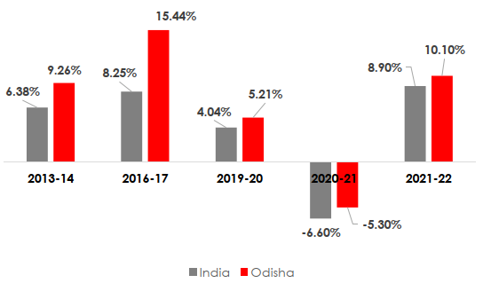
Advantage Odisha: Growth
INR 4 Lakh Crore+
Investment intention received in the last 2 years despite a global pandemic
Economy consistently growing above the national average
Rapid post-pandemic recovery

Slide 3
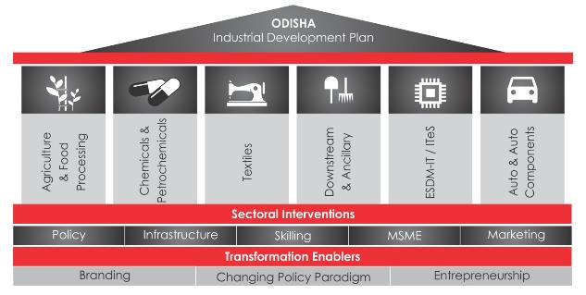
Advantage Odisha: Focus Sectors
“State’s Vision is to attract Rs. 2.5 lakh crore of new investments in 6 identified focus sectors and create
30 lakh jobs opportunities by 2025”
Odisha Industrial Development Plan: Vision 2025
Food Processing including sea food
Chemicals, Plastics & Petro chemicals
Ancillary & Downstream industries in Metal sector
Tourism
Textiles & Apparel
ESDM-IT/ITeS
Fastest growing market | Growing demand | Low entry barriers | New Geography | Market for old & new products

Slide 4
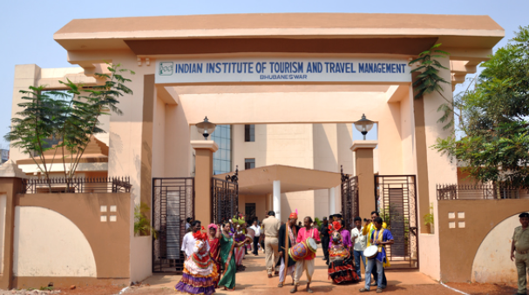
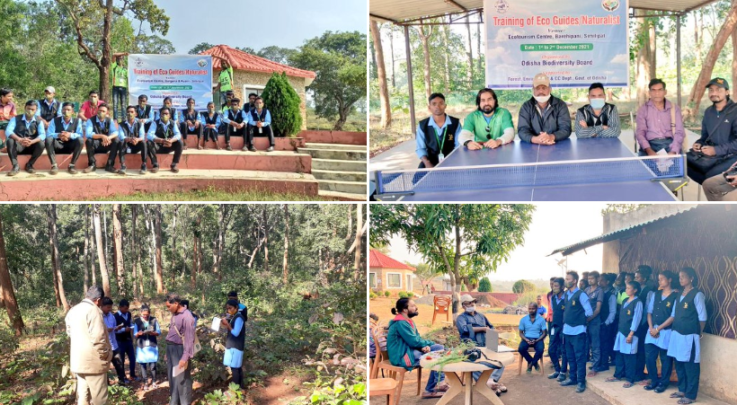
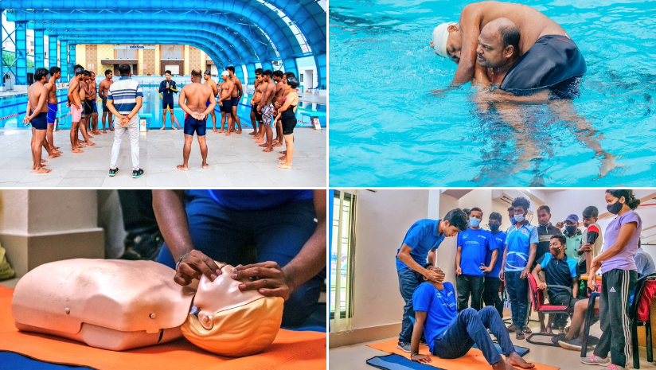
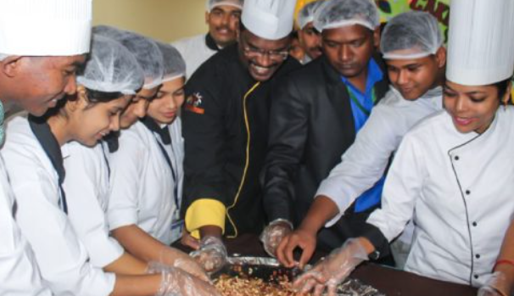
Upskilling in Odisha
Hospitality Institutes – IHM, IITTM & SIHM
Dept. of Tourism conducts various training and capacity building activities on different aspects of tourism regularly for the Industry Stakeholders such as tourist guides, hotel staff, cab drivers, etc. in association with IITTM
Approximately 8000 number of beneficiaries have been trained over the last 10 years.
Dept. of Tourism facilitates entrepreneurial handholding for local/ grassroot entrepreneurs in tourism sector in association with IHM, SIHM, IITTM & leading tourism & hospitality brands
Training on eco-tourism, foreign language, lifeguard, tourist policing, etc. held regularly for tourism industry professionals

Slide 5
Tourism in Odisha – growth drivers
ECONOMIC EMERGENCE
Consistent GSDP growth @7% plus since 2011; higher than national average
Rapidly diversifying industrial base
High quality social infrastructure
GLOCALISING AIR CONNECTIVITY
Bhubaneswar: Best Asia-Pacific Airport for Customer Experience in 2-5 mn band (ACI)
Direct International Connectivity with South East Asia and Middle East expected to commence soon
Jharsuguda Airport connected to Delhi, Kolkata, Hyd, Bangalore, Mumbai & Raipur
Jeypore and Rourkela Airport operationalised.
Airports planned at Charbatia and Utkela
VIBRANT EVENT CALENDAR
Cultural: Ratha Jatra
Performing Arts – Konark, Mukteswar, Raja Rani, Dhauli Kalinga
Sports – Hockey, Football, Table Tennis, Surfing, etc.
Trade & Merchandising – Toshali Crafts Mela, Tribal Crafts Mela
Ecotourism – Eco Retreat, Chilika Bird Festival

Slide 6
Tourism in Odisha – growth drivers
DIVERSE TOURISM EXPERIENCES
Beach Tourism
Spiritual Tourism
Heritage Tourism
Wildlife & Ecotourism
MICE Tourism
Health & Wellness Tourism
Ethnic Tourism
Art & Craft Tourism
Caravans & Camping
Cruises & Houseboats
PROACTIVE POLICY FACILITATION
Odisha Tourism Policy 2022 offers a set of relevant incentives
Special Single Window System has approved over 126 tourism projects since its inception
Entry of brands such as Vivanta, ITC Welcom, LemonTree, Novotel, Hyatt, Mariott, WonderLa etc.
High priority to leasing out Tourism Dept. properties in prime destinations in PPP mode
SUSTAINED PROMOTION CAMPAIGN
Multi-pronged strategy adopted for branding, outreach & destination promotion
National & International campaigns across focus markets
Investment in boosting digital dynamism through revamped website and social media
Proactive stakeholder networking through OTB, OTM, ITB Berlin, WTM London, PATA Malaysia, etc., apart from promotion roadshows

Slide 7
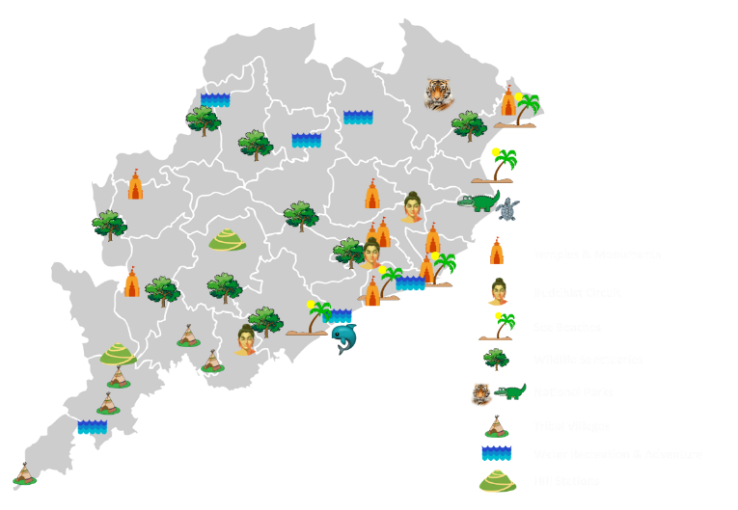
One State, many experiences
Spiritual & Heritage Tourism
Coastal & Wetland tourism
Chilika Lake
Bhitarkanika Mangroves
Eight major dam sites incl. Hirakud
Ecotourism & Wildlife Tourism
Art & Craft Tourism
Ethnic Tourism
Fairs and Festivals
Sports Tourism

Slide 8
Sonapur
Putsil
Launched in 2019, this three-month glam camp is an environmentally sustainable model incorporating best practices in material utilisation and holistic waste management. The event is held in exotic and bio-diverse rich locations across Odisha. From one location – Konark in its 1st edition during 2019-2020 to 7 locations in its 4th edition of 2022-2023, Eco Retreat Odisha has been attracting travellers to visit less explored destinations of the State.

Slide 9
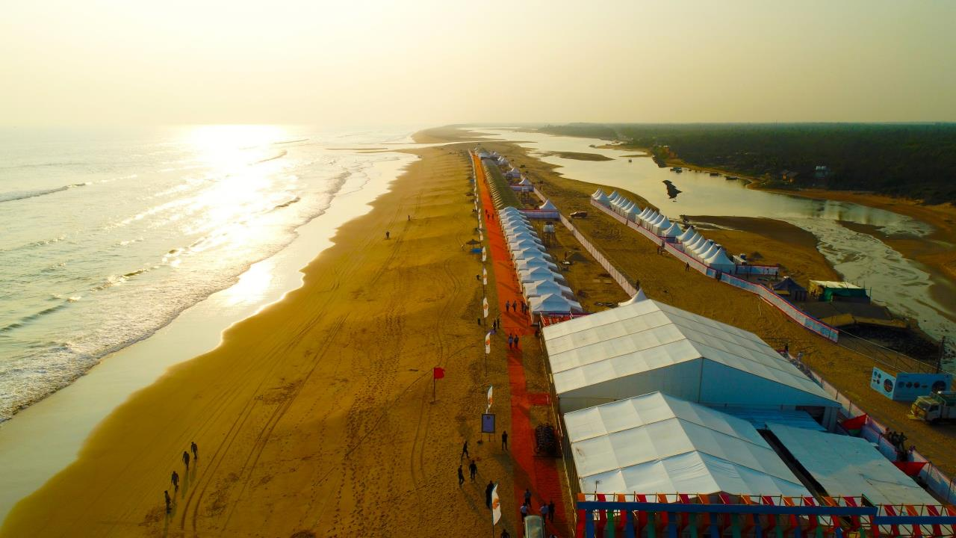
Eco Retreat Odisha
From enchanting beaches to amazing wildlife areas, choose one or choose many from among 7 exotic locations this year. Plan your luxury escapade to pristine beaches of Konark, Sonapur and Bhitarkanika, adventure getaway to Hirakud and Satkosia or a relaxing trip to quaint hillstations of Daringbadi and Koraput. Visit Eco Retreat Odisha for an experience of a lifetime!
Exciting road itineraries…
a million experiences!

Slide 10
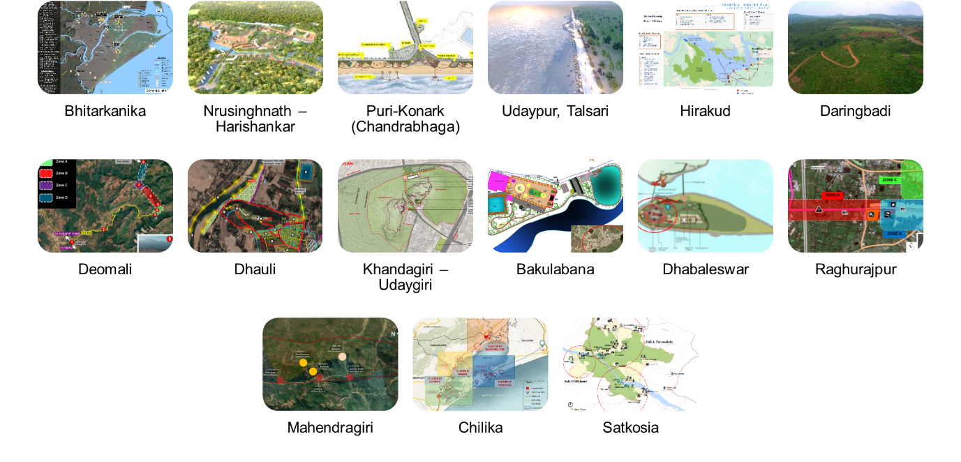
17 Integrated Masterplans

Slide 11
Investment facilitation and Promotion
126
INR 6,065 Cr
6,000+
500+
Tourism projects approved
Investments Approved
Employment (Direct and Indirect)
Motivate local entrepreneur/investor
Land bank for tourism projects – 2,000 Acres

Slide 12
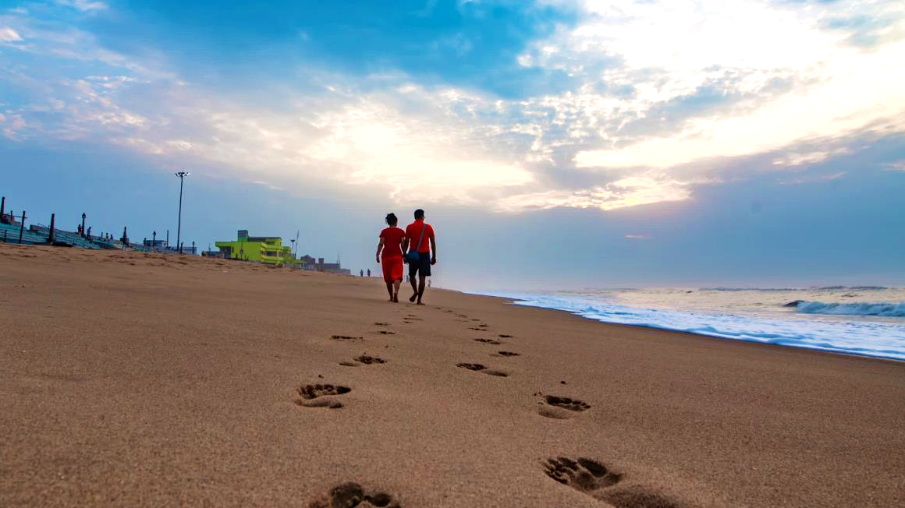
Come, discover
Thank you!

